Slide 1

Introduction to Microcontrollers Fall Term, 2021
Professor Allan Douglas

Slide 2
Schedule/Labs
Lab#2 is due tonight by midnight.
Lab#3 has been posted on Canvas.
Due 11/2/21 by midnight

Slide 3
Lecture Outline
SPI Interface
AVR Computer Architecture
AVR Memory Map
Arithmetic Logic Unit (ALU)
General Purpose Registers
Status Register (SREG)
Examples and Status Register Flags
Lab#3
Liquid Crystal Display (LCD)
Real Time Clock (RTC)
Integration

Slide 4
MicroChip MCP23S08 Port Expander
MCP20S08 also has a chip select pin that is not shown on this diagram.

Slide 5
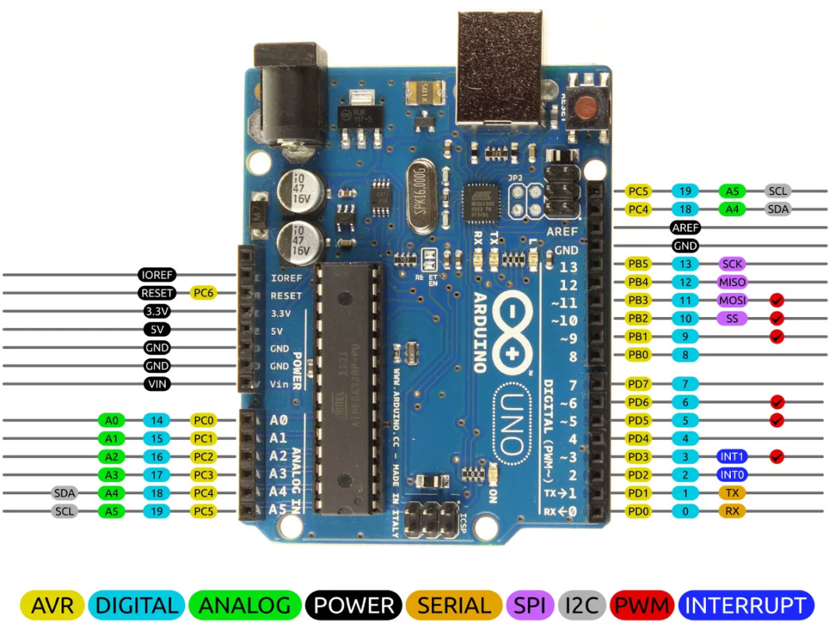
SPI Physical Connections
Arduino Connections
MOSI pin 11 -> SI
MISO pin 12 -> SO
SCK pin 13 -> SCK
SS pin 10 -> /CS
MicroChip MCP23S08
IC I/O EXPANDER SPI 8B 18DIP

Slide 6
SPI Physical Connections

Slide 7
SPI Port Expander

Slide 8
SPI Port Expander Registers

Slide 9
SPI Port Expander Registers

Slide 10
SPI Port Expander Registers

Slide 11
Writing to Port Expander Registers
How did you connect A1 and A0?
Need to write the data byte here
before you de-assert the chip select.
Register Address 0x00 of 0x09?

Slide 12
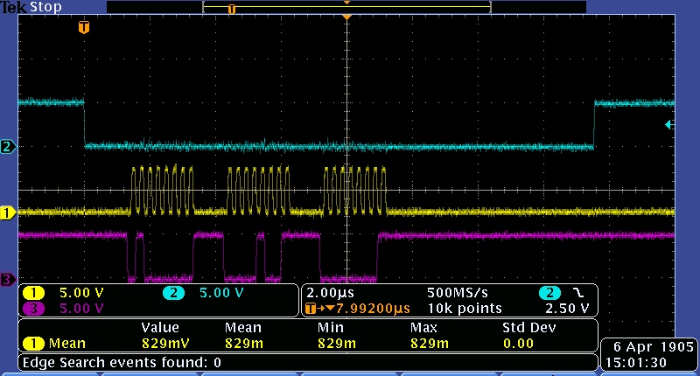
SPI Port Expander Write
Device Opcode
Address
Data

Slide 13
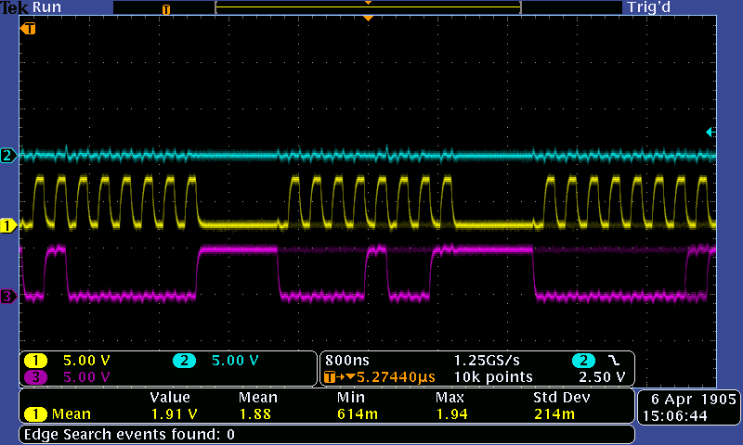
SPI Port Expander Write
A1=0
A0=0
0100_0000=0x40
R/W = 0 = Write
0000_1001=0x09
0000_0001=0x01
alternating
0000_0000=0x00
to blink LED

Slide 14
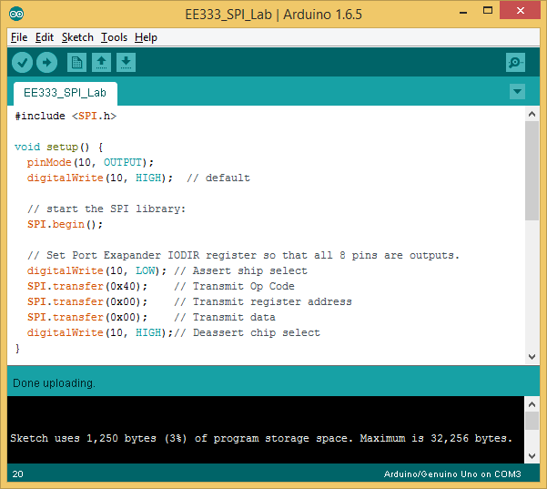
Example SPI Code
Include the SPI library
Setup the chip select pin
Start the SPI library
Setup the Port Expander
IODIR register. Make all
8-bits outputs.

Slide 15
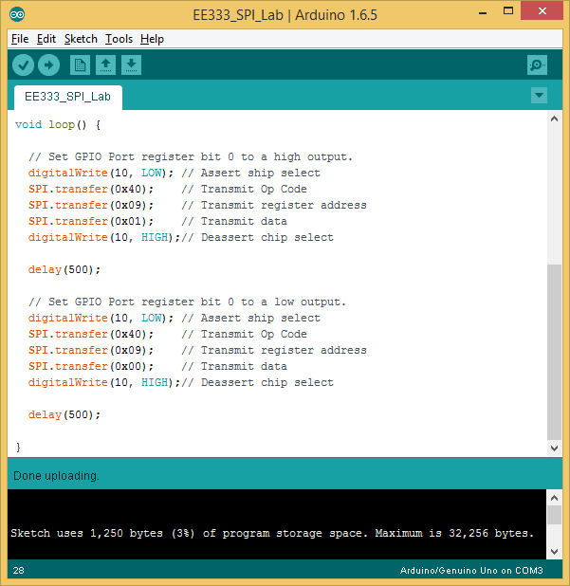
Example SPI Code
Drive the LSB of the
port expander high.
Delay 500ms
Drive the LSB of the
port expander low.
Delay 500ms

Slide 16
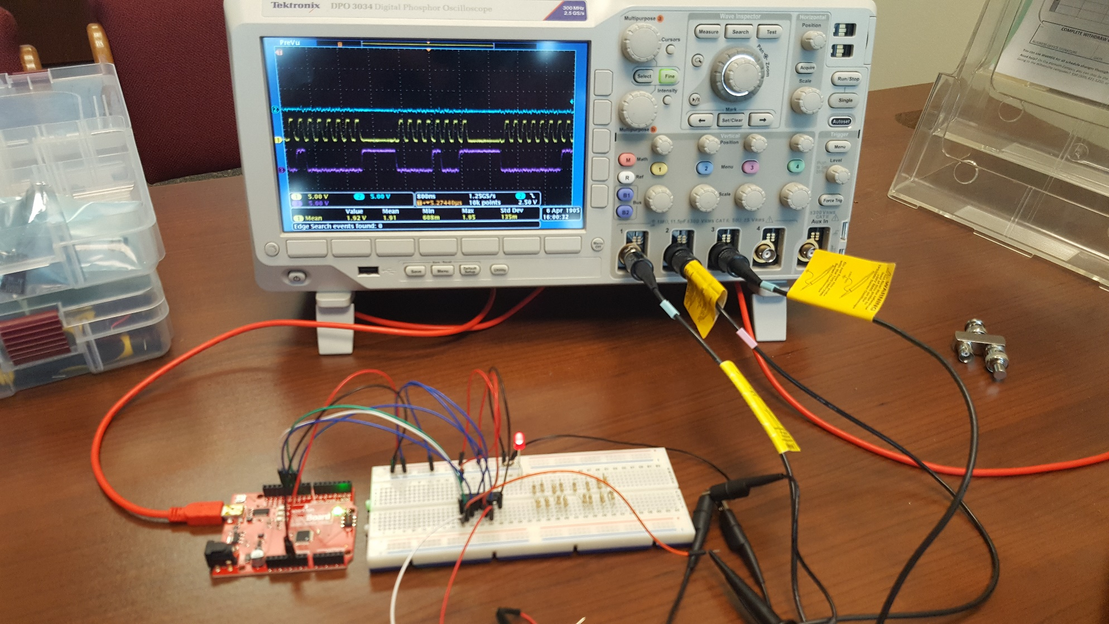
Working SPI Port Expander

Slide 17
SPI (ATmega328P) Hardware

Slide 18
SPI (ATmega328P) Hardware

Slide 19
SPI (ATmega328P) Hardware

Slide 20
SPI (ATmega328P) Hardware

Slide 21
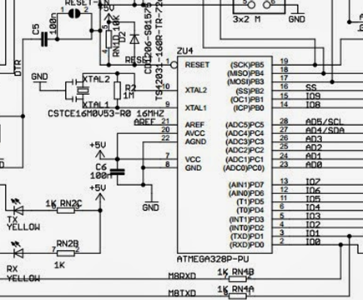
SPI (ATmega328P) Hardware
For the Adrudio (ATMega328P), f_{OSC} = 16MHz

Slide 22
SPI (ATmega328P) Hardware

Slide 23
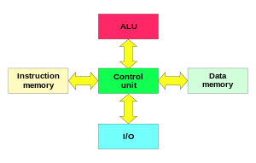
Computer Architecture
The Harvard architecture is a computer architecture with physically separate storage and signal pathways for instructions and data.
In a Harvard architecture, there is no need to make the two memories share characteristics. In particular, the word width, timing, implementation technology, and memory address structure can differ.
In some systems, instructions can be stored in read-only memory (Flash) while data memory generally requires read-write memory (SRAM).
In some systems, there is much more instruction memory than data memory so instruction addresses are wider than data addresses.
Wikipedia

Slide 24
Harvard vs. von Neumann
Under pure von Neumann architecture the CPU can be either reading an instruction or reading/writing data from/to the memory.
Both cannot occur at the same time since the instructions and data use the same bus system.
In a computer using the Harvard architecture, the CPU can both read an instruction and perform a data memory access at the same time.
A Harvard architecture computer can thus be faster for a given circuit complexity because instruction fetches and data access do not contend for a single memory bus.

Slide 25
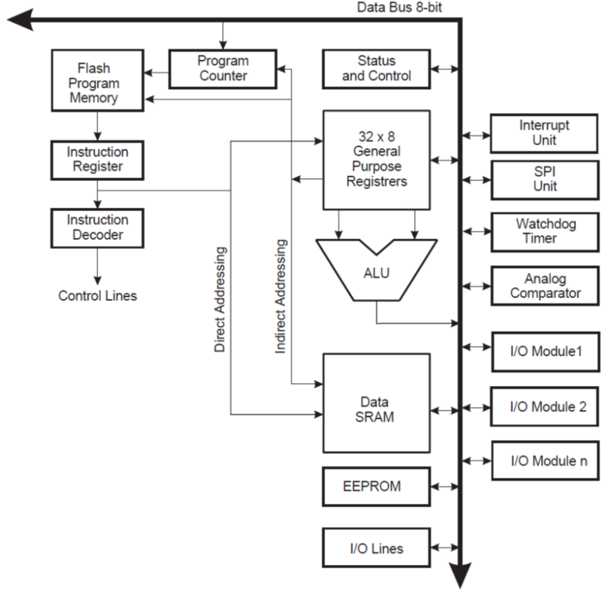
AVR Microcontroller Architecture
14-bits
32kBytes
SREG
2^14 = 16,384 addresses
16-bits
8-bits
8-bits
8-bits
ATmega328P Data Sheet, downloaded from http://www.atmel.com

Slide 26
Flash Program Memory Map
16-bits wide
ATmega328P has 32KBytes
Last byte address is 0x3FFF
ATmega328P Data Sheet, downloaded from http://www.atmel.com

Slide 27
Data Memory Map
32 General Purpose Registers
I/O Registers on class handout
2KBytes for ATmega328P
ATmega328P Data Sheet, downloaded from http://www.atmel.com

Slide 28
Instruction Fetches and Execution
Parallel instruction fetches and instruction executions enabled by the Harvard architecture and the fast-access Register File concept.
This is the basic pipelining concept to obtain up to 1 MIPS per MHz.
ATmega328P Data Sheet, downloaded from http://www.atmel.com

Slide 29
ALU Single Cycle Operation
This is the internal timing concept for the Register File.
In a single clock cycle an ALU operation using two register operands is executed, and the result is stored back to the destination register.
ATmega328P Data Sheet, downloaded from http://www.atmel.com

Slide 30
AVR Microcontroller Architecture
32kBytes
AVR CPU
2kBytes
ATmega328P Data Sheet, downloaded from http://www.atmel.com

Slide 31
General Purpose Registers

Slide 32
Arithmetic Logic Unit
The high-performance AVR ALU operates in direct connection with all the 32 general purpose working registers.
Within a single clock cycle, arithmetic operations between general purpose registers or between a register and an immediate are executed.
The ALU operations are divided into three main categories
arithmetic
logical
bitwise-functions
Some implementations of the architecture also provide a powerful multiplier supporting both signed/unsigned multiplication and fractional format.

Slide 33
Status Register
The Status Register contains information about the result of the most recently executed arithmetic instruction.
This information can be used for altering program flow (branching) in order to perform conditional operations.
Note that the Status Register is updated after all ALU operations, as specified in the Instruction Set Reference.
This will in many cases remove the need for using the dedicated compare instructions, resulting in faster and more compact code.
ATmega328P Data Sheet, downloaded from http://www.atmel.com

Slide 34
Status Register
C Carry flag. This is a borrow flag on subtracts.
Z Zero flag. Set to 1 when an arithmetic result is zero.
N Negative flag. Set to a copy of the most significant bit of an arithmetic result.
V Overflow flag. Set in case of two's complement overflow.
S Sign flag. Unique to AVR, this is always N⊕V, and shows the true sign of a comparison.
H Half carry. This is an internal carry from additions and is used to support BCD arithmetic.
T Bit copy. Special bit load and bit store instructions use this bit.
I Interrupt flag. Set when interrupts are enabled.
ATmega328P Data Sheet, downloaded from http://www.atmel.com

Slide 35
AVR Instruction Set
Consider the following:
ADC – Add with Carry instruction
0000_1111 Rd
+ 0000_0001 Rr
0001_0000 R
What are the values of the flags?

Slide 36
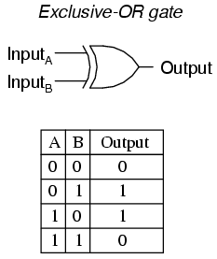
AVR Instruction Set
Consider the following:
ADC – Add with Carry instruction
1 C
1010_1111 Rd
+ 1001_1001 Rr
1_0100_1001 R
What are the values of the flags?

Slide 37
Other Instructions
If you are interested in additional Assembly Language programming details for the AVR Microcontrollers, please review the following pdf file.
http://www.atmel.com/images/atmel-0856-avr-instruction-set-manual.pdf

Slide 38
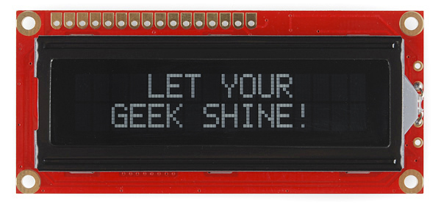
Lab#3
Liquid Crystal Display (LCD)
https://www.sparkfun.com/products/709
We are only using 4 data pins (DB4-DB7) to control the device
Contrast
Adjustment

Slide 39
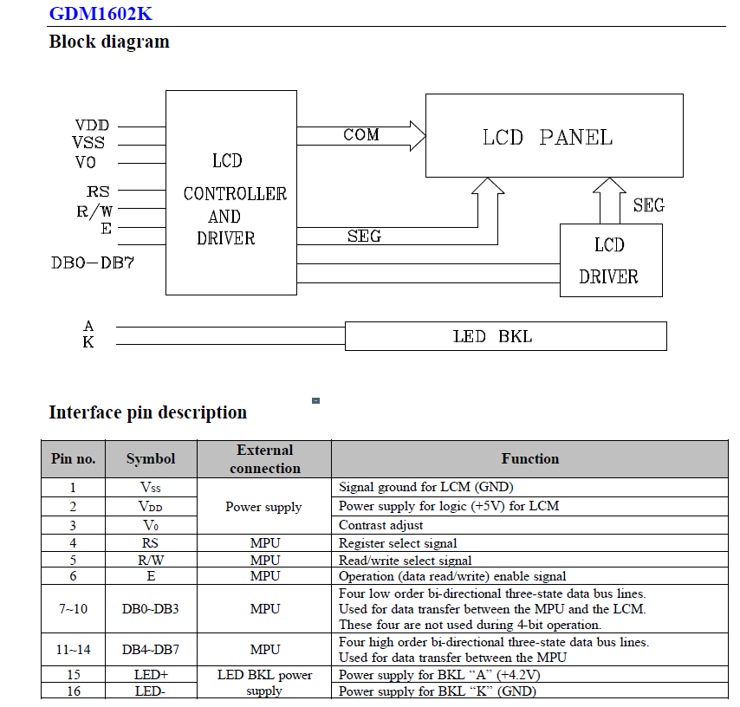
LCD Control Interface

Slide 40
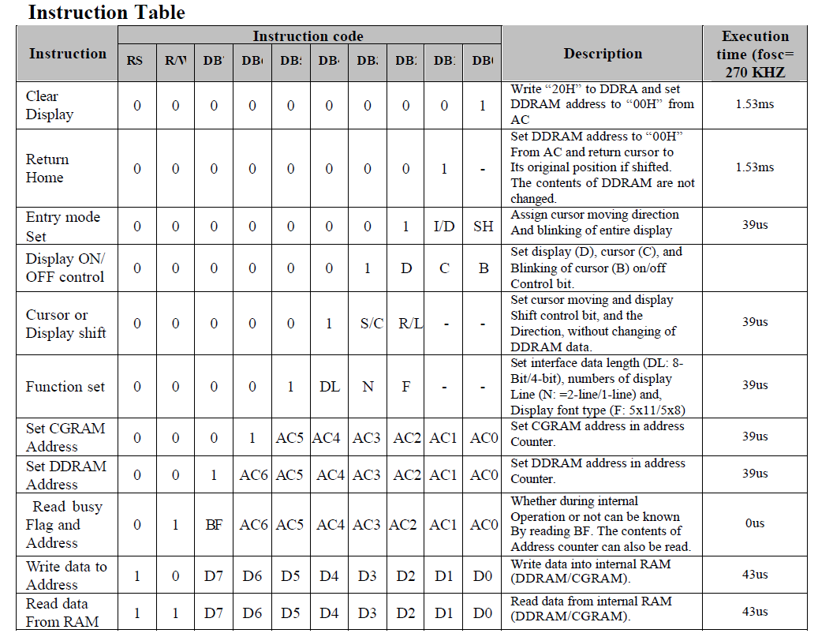
LCD Technical Details

Slide 41
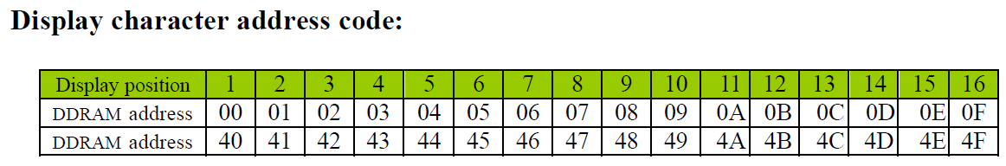
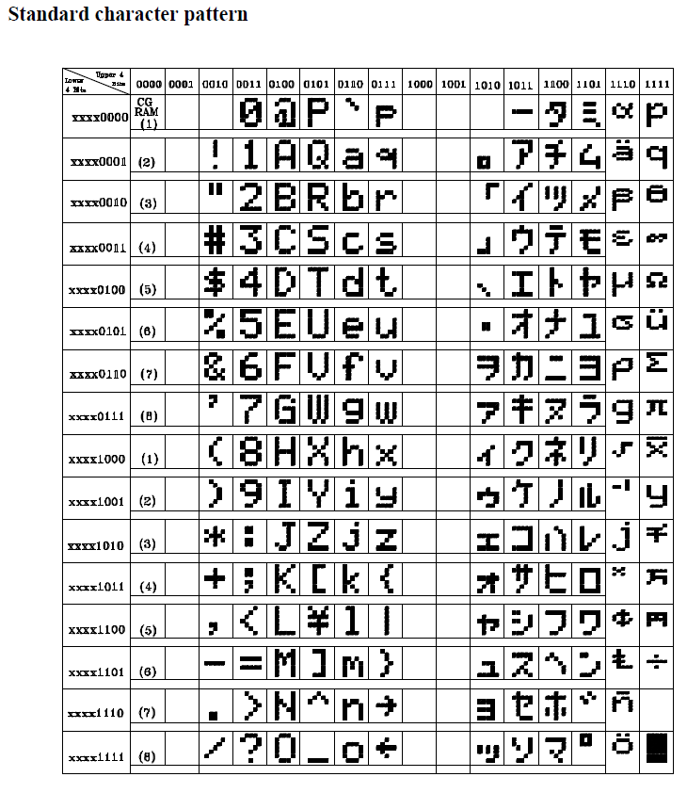
LCD Technical Details
2x16 Character Display

Slide 42
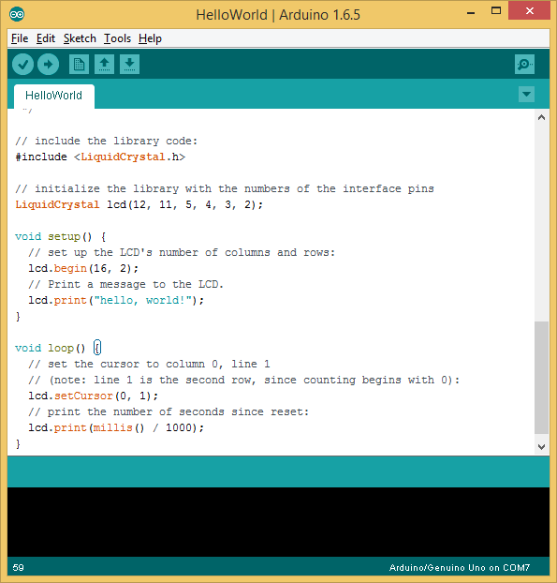
HelloWorld Sketch

Slide 43
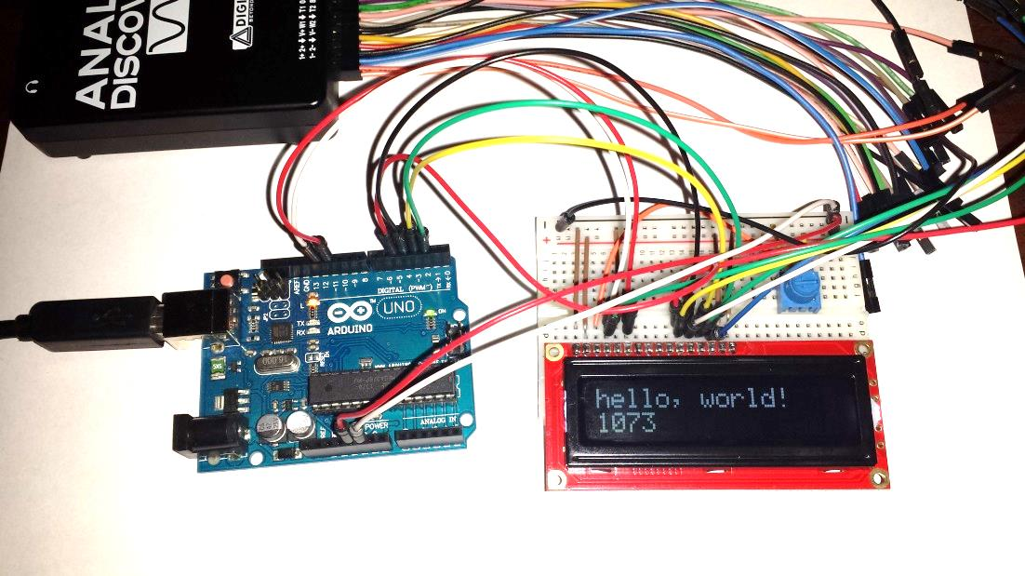
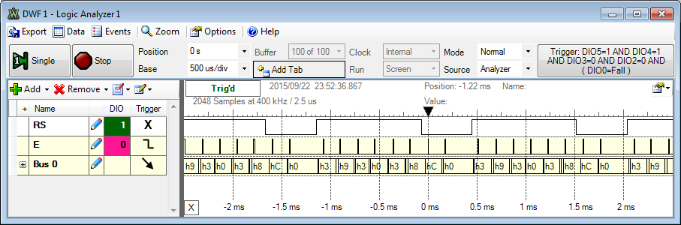
Observing the Digital Interface
Running the HelloWorld
DDRAM Address
DDRAM Data

Slide 44
Real Time Clock
DS1307 Real Time Clock (RTC)
http://datasheets.maximintegrated.com/en/ds/DS1307.pdf
I²C Interface

Slide 45
Real Time Clock
Bit 7 of Register 0 is the clock halt (CH) bit. When this bit is set to 1, the oscillator is disabled. When cleared to 0, the oscillator is enabled.
On first application of power to the device the time and date registers are typically reset to 01/01/00 01 00:00:00 (MM/DD/YY DOW HH:MM:SS). The CH bit in the seconds register will be set to a 1.
The clock can be halted whenever the timekeeping functions are not required, which minimizes current (IBATDR).
We will need to clear the CH bit in the setup() function in our sketches.

Slide 46
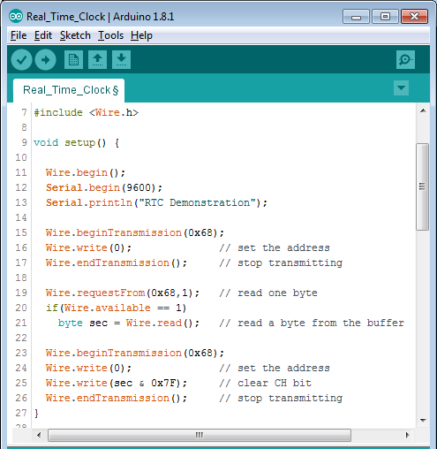
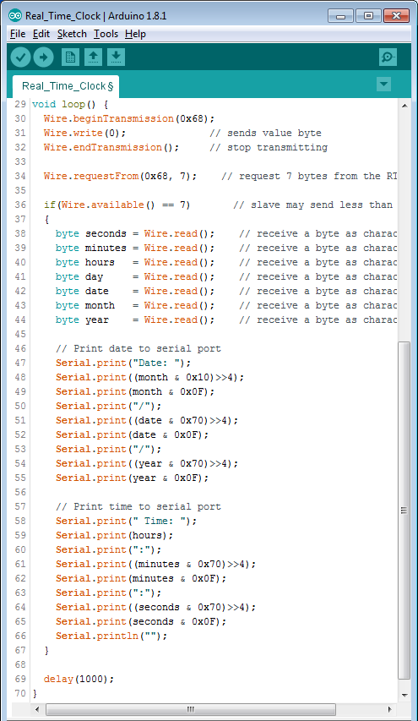
Real_Time_Clock Sketch
Bitwise Operations
Bitwise AND

Slide 47
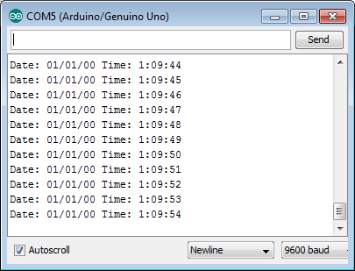
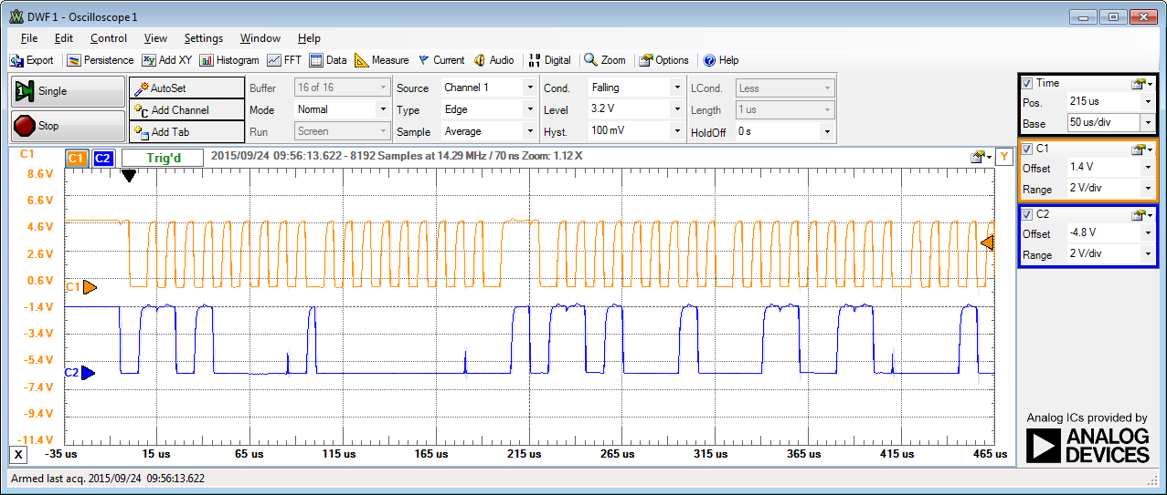
RTC Operation
Current time displayed on
serial console. Updated once per second.
Bit patterns contain current
Date and time information.

Slide 48
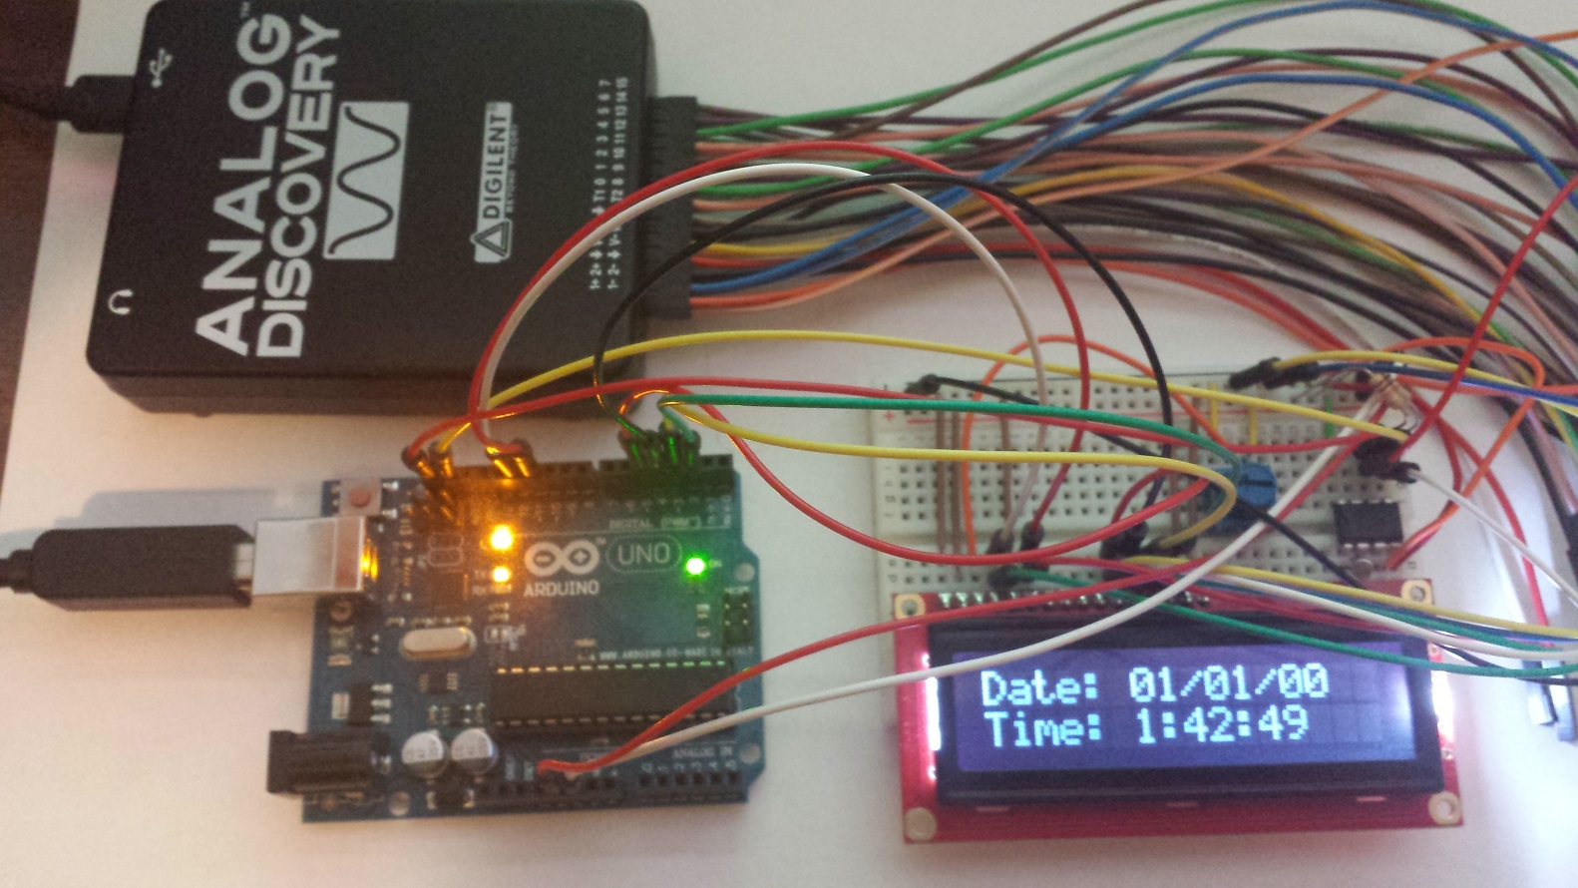
Integrating the LCD and RTC

Slide 49
Lab#3
Lab Overview
In this lab, students will learn how to interface the Arduino UNO with an LCD display, and a Real-Time Clock IC. The two additional components will be used to create a digital clock that displays the time and date.
Required Work
Part 1: Liquid Crystal Display (LCD)
Technical information about the LCD can be found at https://www.sparkfun.com/products/709. The best resource is the Extended Data Sheet.
Connect the LCD and potentiometer as shown:
Load the example sketch called HelloWorld (File>Examples>HelloWorld). You should see something like the following figure. Make sure to adjust the potentiometer to set the LCD contrast so that the display is visible.

Slide 50
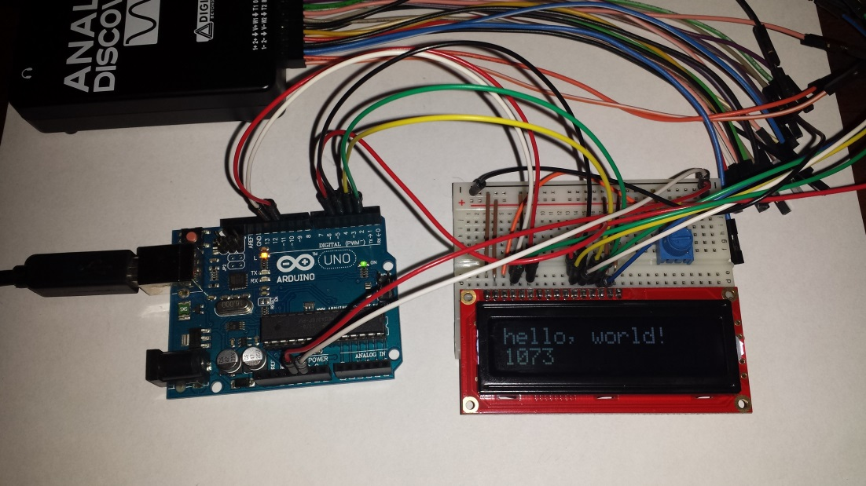
Lab#3
The number that is incrementing in the second row is the number of seconds that the microcontroller has been running since the reset was asserted.
Next, connect the signals called RS, E, D4-D7 to a logic analyzer. You should get a set of signals that looks like the following figure.

Slide 51
Lab#3
The microcontroller writes character data to LCD internal memory over a 4-bit parallel bus. Read the datasheet for the LCD and describe how the microcontroller code in the sketch is creating the display. Relate the commands in the sketch to the signals you observe on the logic analyzer.
Part 2: Real Time Clock (RTC)
The datasheet for the DS1307 RTC can be found here http://datasheets.maximintegrated.com/en/ds/DS1307.pdf
Place the RTC into your breadboard and connect the 32.768 kHz crystal across the X1 and X2 pins. Connect 5V and ground to the chip. Finally, connect the I2C SCL and SDA pins from the microcontroller to the RTC. Connect the RTC Vbat pin to ground.
Download the sketch called Real_Time_Clock from Canvas. Load the sketch into the microcontroller. You should see an output on the Serial Monitor that looks like the following:

Slide 52
Lab#3
If the sketch does not work, check your connections.
Observe the SCL and SDA pins on the microcontroller. You should see something like the following:
Decode every bit on the I2C bus and explain how this relates to the microcontroller code in the sketch.
Examine the code in the sketch and explain how it works in your own words. Make sure to carefully explain the portions of code that write to the serial port. What do these portions of the code do?
Serial.print((minutes & 0x70)>>4);
Serial.print(minutes & 0x0F);

Slide 53

Lab#3
Wire.beginTransmission(0x68);
Wire.write(0); // set the address
Wire.write(sec & 0x7F); // clear CH bit
Wire.endTransmission(); // stop transmitting
Why is this necessary?
Part 3: Creating a Digital Clock
Use what you have learned about the LCD and the RTC to build a digital clock. You will need to write your own code for this part of the lab. You may use functions from the other two sketches. You working sketch should look like the following figure.

Slide 54
Lab#3
Required Work Checklist
□ Part 1. Include all measured waveforms. Answer all questions stated in the section. Include a complete description of the HelloWorld sketch.
□ Part 2. Include all measured waveforms. Answer all questions stated in the section. Include a complete description of the Real_Time_Clock sketch.
□ Part 3. Include a complete copy of your sketch. Make sure your code is commented.
Include a picture of the working LCD displaying both the formatted date and time.
Extra Credit Work
1. Add a function to the sketch you wrote in Part 3 that sets the time and date on the RTC. You will need to write data to the RTC over the I2C bus.
2. Connect a 3V power supply (battery) to the Vbat pin and connect the power supply to ground on your breadboard.
3. Note the current time and disconnect the microcontroller from USB (power).
4. Reconnect after about 10 seconds. Confirm that the RTC time continues tracking the time accurately.
Extra Credit Checklist
□ Include a copy your sketch and describe your new function.
□ Include a picture of your RTC Vbat power supply.
□ Explain how the RTC continues to operate without power from the Arduino UNO board.

